Slide 1
Nextcloud
Efstathios Iosifidis
iosifidis@opensuse.org
Notes:
Welcome!

Slide 2
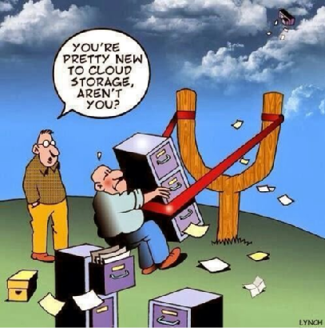
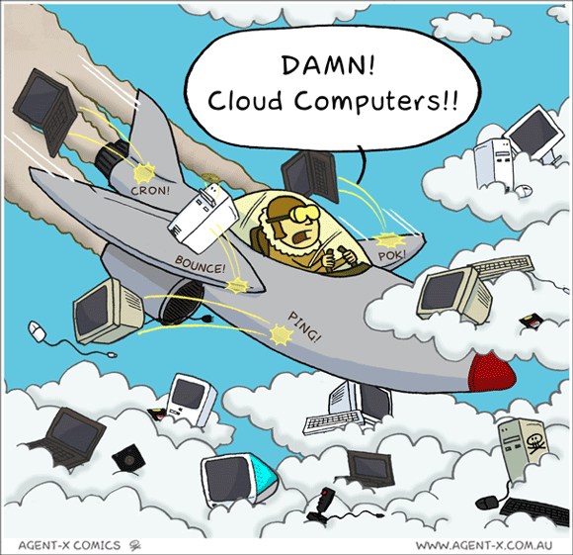
CLOUD
Notes:
Going to talk about how to take your data back with NextCloud

Slide 3
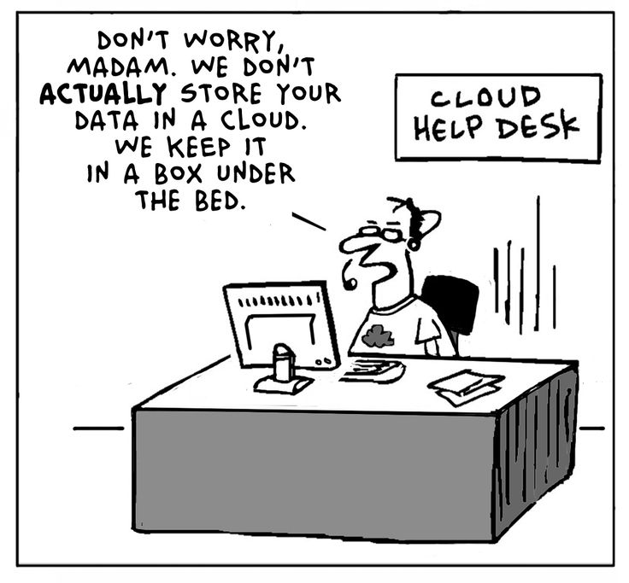
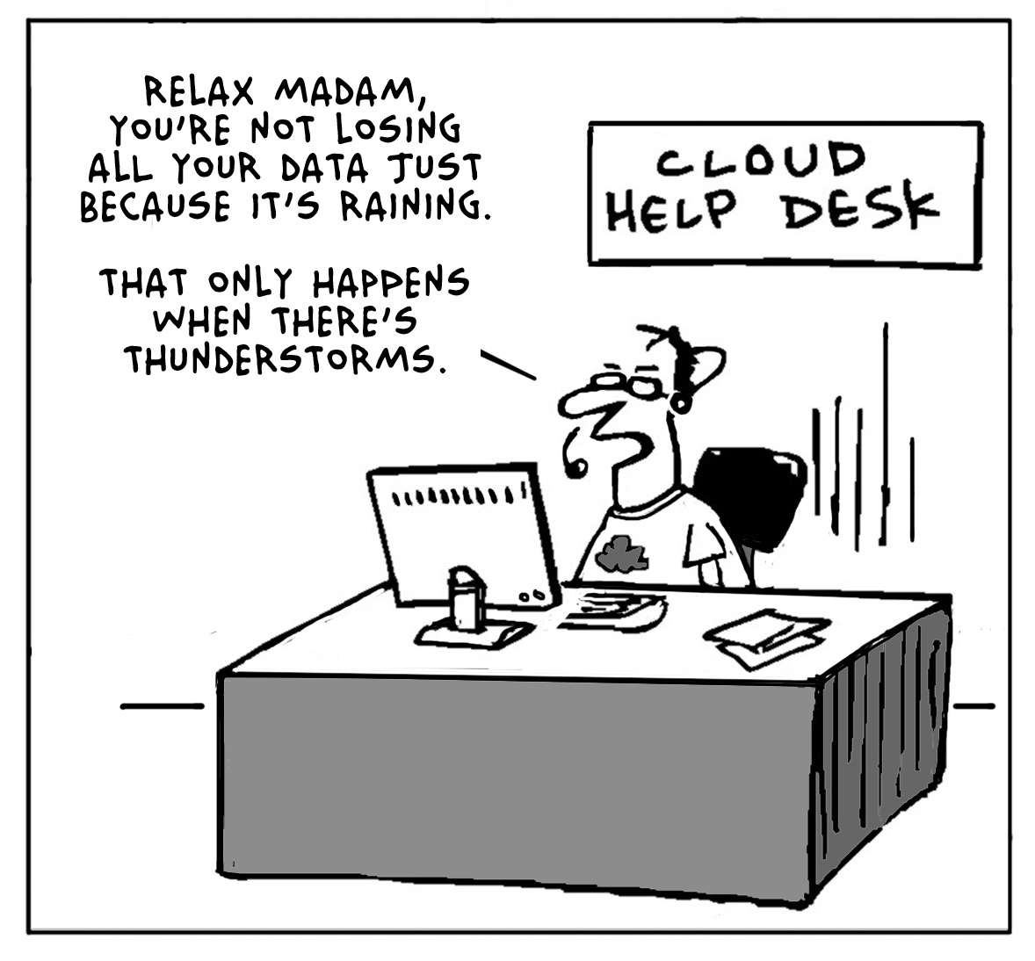
CLOUD
Notes:
Going to talk about how to take your data back with NextCloud

Slide 4
Agenda
Why
What
How
Notes:
Going to talk about how to take your data back with NextCloud

Slide 5
Why cloud
Access files
Access calendar
Access mail
Access contacts
Easy sharing and collaboration
All free!!!
Notes:
Post-snowden. - where you under a rock?
Governments, own and foreign
Companies
Criminal organizations and terrorists
In no small part due to bad policy of government – they want us to be vulnerable to them so we are vulnerable to everybody.

Slide 6
Cloud data questions...
Where is my data?
Who can access my data?
Notes:
Post-snowden. - where you under a rock?
Governments, own and foreign
Companies
Criminal organizations and terrorists
In no small part due to bad policy of government – they want us to be vulnerable to them so we are vulnerable to everybody.

Slide 7
Why Nextcloud
Privacy
Security
Notes:
Post-snowden. - where you under a rock?
Governments, own and foreign
Companies
Criminal organizations and terrorists
In no small part due to bad policy of government – they want us to be vulnerable to them so we are vulnerable to everybody.

Slide 8
About Nextcloud
File sync and share
Open Source
Easy to use
Easy to install
Easy to extend
>8 million users!
Notes:
We need to own our data. And ownCloud helps you do that.
ownCloud is a file sync and share technology. You run ownCloud on your own server or pick one of the 30+ ownCloud providers.
Both server and clients are open source and are developed with the goals of being easy to install, use and extend.
ownCloud has over 2 million users, making it by far the most popular open source file sync and share technology.

Slide 9


Easy to use
Easy to deploy: LAMP
Easy to improve on or inspect: PHP, JS, CSS
All-platform access
Scale from Raspberry Pi to CERN
Notes:
blabla

Slide 10
Extensible
Nextcloud Apps
mail, calendar, music, password manager, chat, podcasts, notes… ...
apps.nextcloud.com
coming for Nextcloud 11
Notes:
ownCloud is a platform you can build apps on
Over 300 available
Get some examples later
Top ten has 30 to 55K downloads

Slide 11
Comparison
 | Google Drive | One Drive (MS) | Dropbox | iCloud | Nextcloud
Size | 15GB | 15GB | 2GB | 5GB | Unlimited
Calendar | Yes | Yes | No | Yes | Yes
Contacts | Yes | Yes | No | Yes | Yes
Extra | Google docs, Photos | Office online |  | Pages, Numbers, Keynote, Photos | Documents, Apps
Mail | Gmail | Outlook | No | Yes | Personal-APP
Clients | Mobile-PC | Mobile-PC | Mobile-PC | Mobile-PC | Mobile-PC
Safety | Google | Microsoft | Dropbox | Apple | YOU
Notes:
ownCloud is a platform you can build apps on
Over 300 available
Get some examples later
Top ten has 30 to 55K downloads

Slide 12
Nextcloud - For administrators
Notes:
Nextcloud is easy to maintain, but gives a lot of control to system administrators.

Slide 13
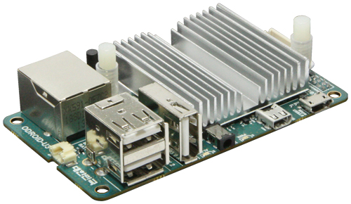
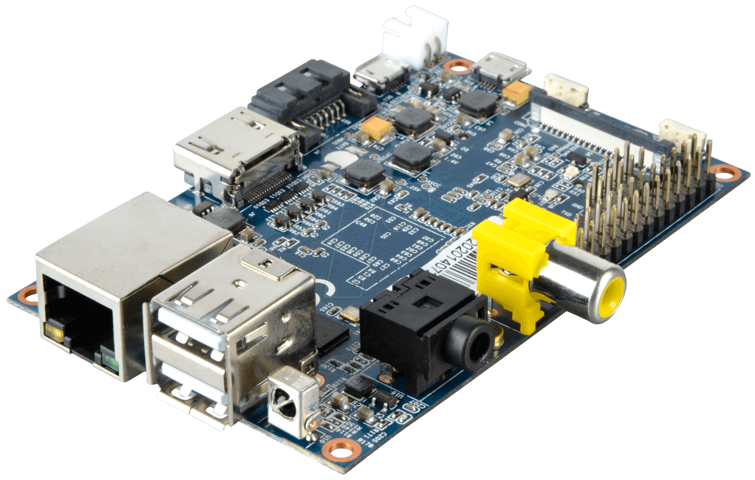

What you need...
System - Storage
Bandwith - 24/7/365 online
LAMP (read documentation)
Nextcloud

Slide 14
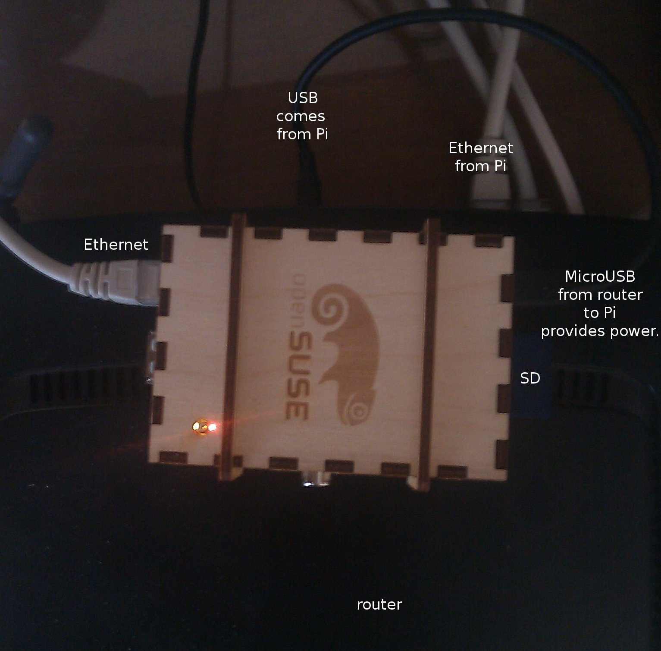
The Pi

Slide 15
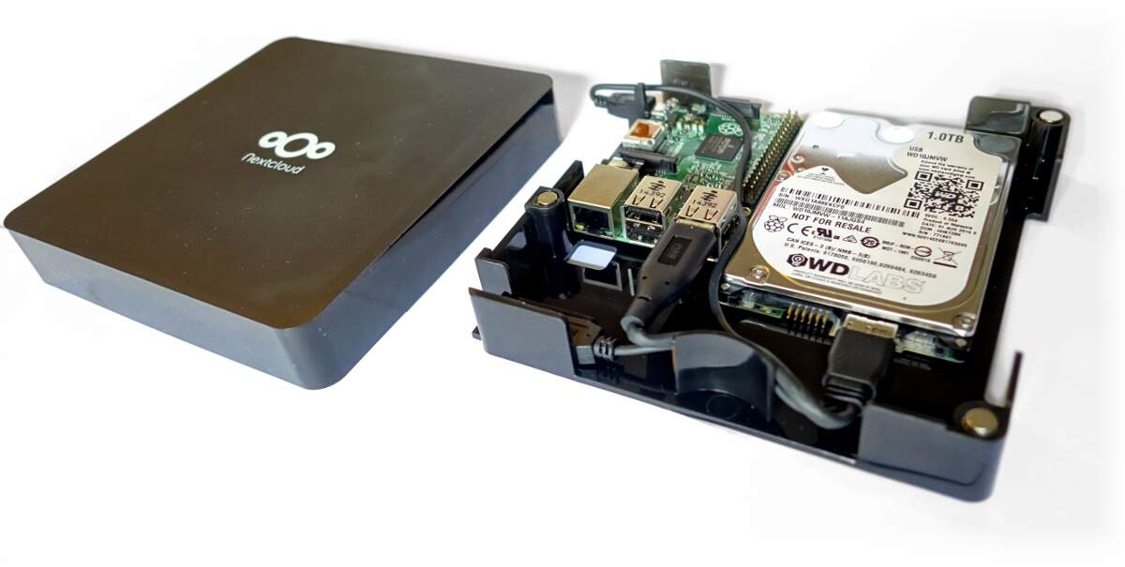
https://nextcloud.com/box/

Slide 16
The process
Step 1: prepare OS image, boot up the Pi
Step 2: SSH into the Pi. Static IP, install LAMP
Step 3: install and configure Nextcloud
Most magic is in step 2: making a wired connection between the Pi and your laptop and SSH'ing in.
Step 3 can take as long as you want – there is plenty to improve secure and optimize once Nextcloud is up and running.
Brought your own system to install Nextcloud on? Start step 2.

Slide 17
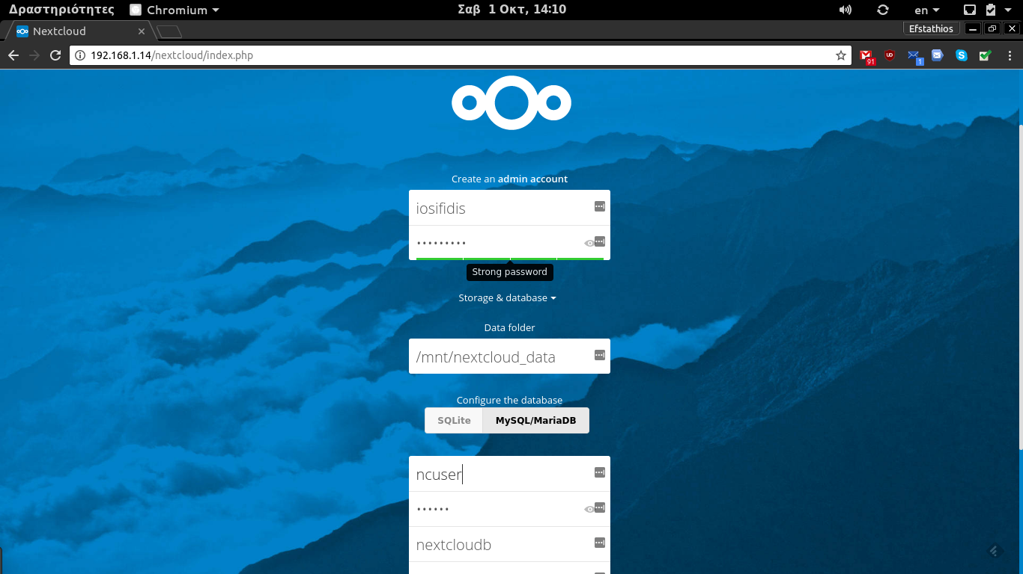
Nextcloud Install

Slide 18
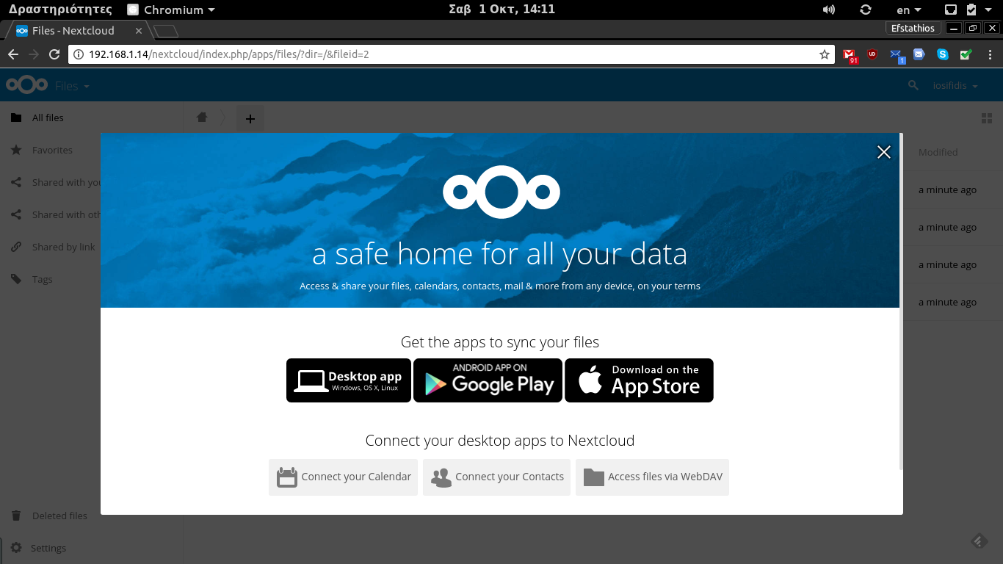
First login

Slide 19
Nextcloud - For end users
Notes:
Let's talk about what Nextcloud has to offer for end users.

Slide 20
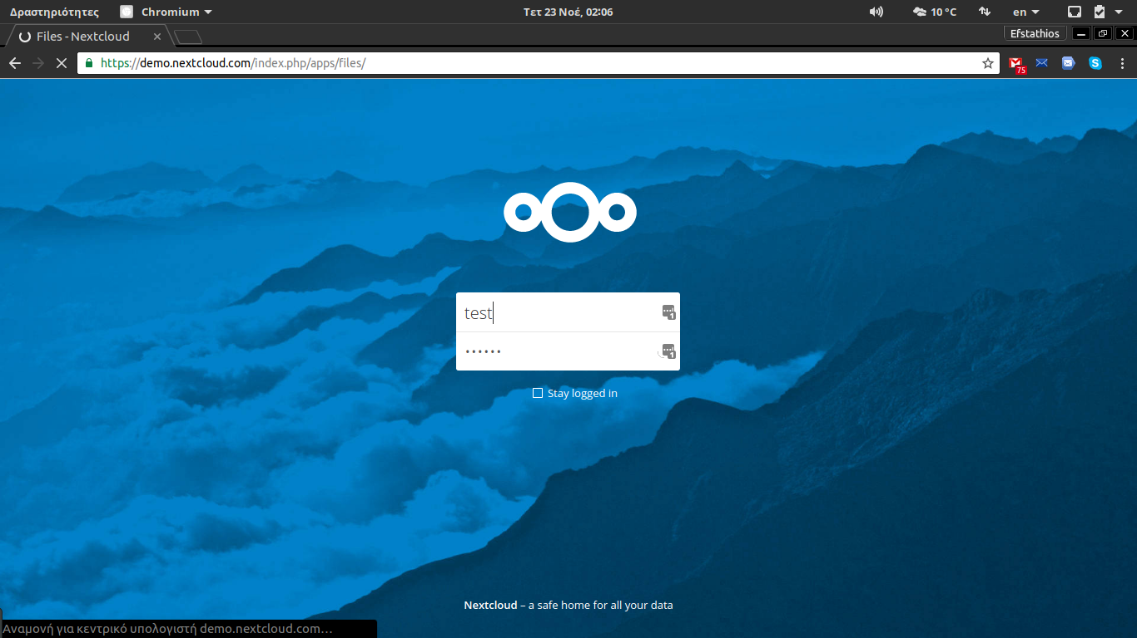

Slide 21
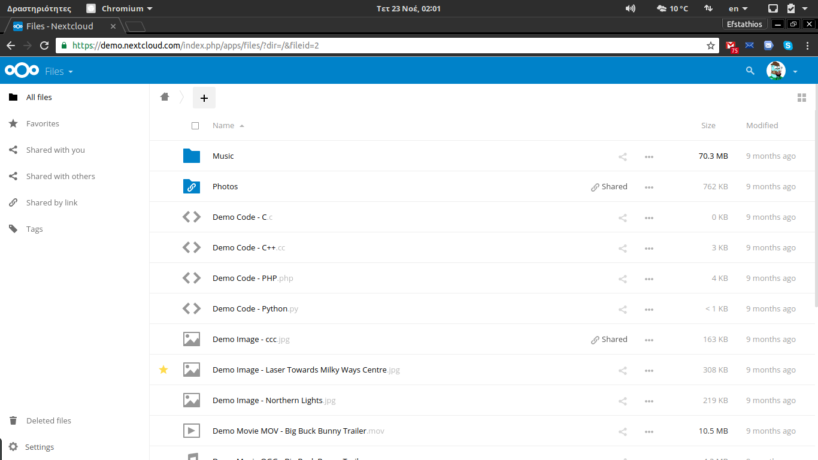

Slide 22
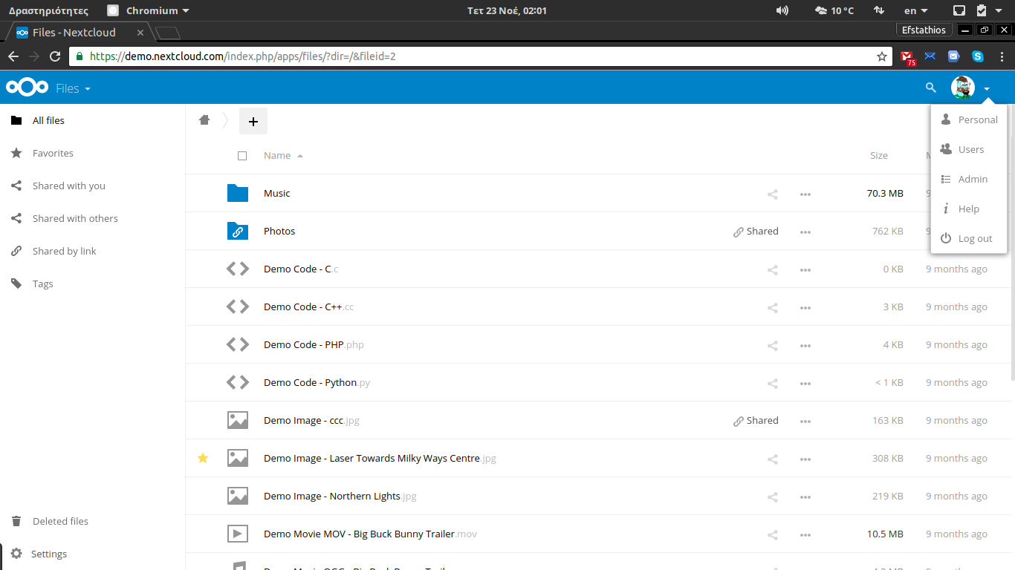

Slide 23
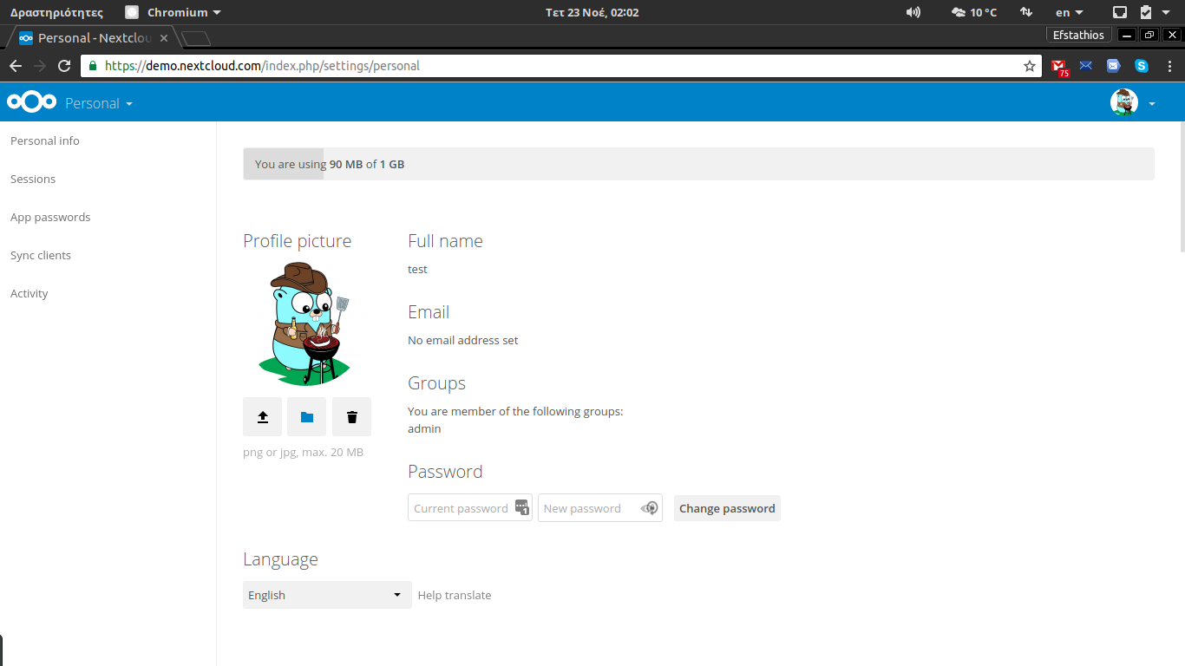

Slide 24
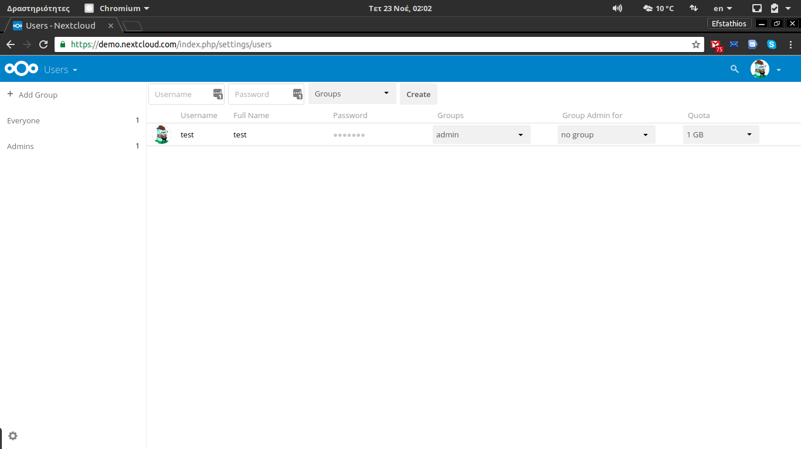

Slide 25
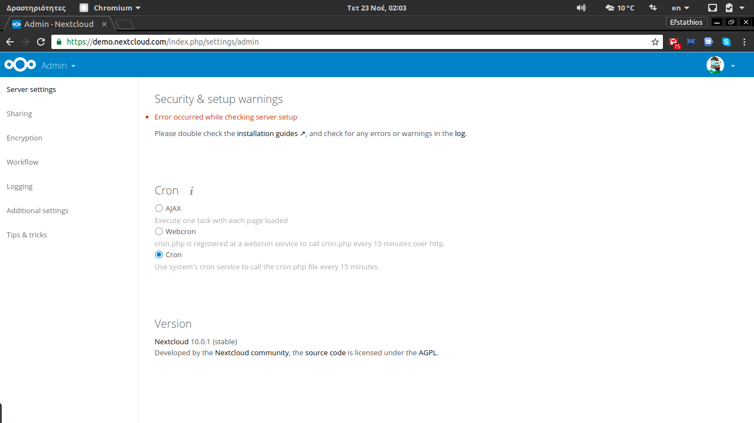

Slide 26
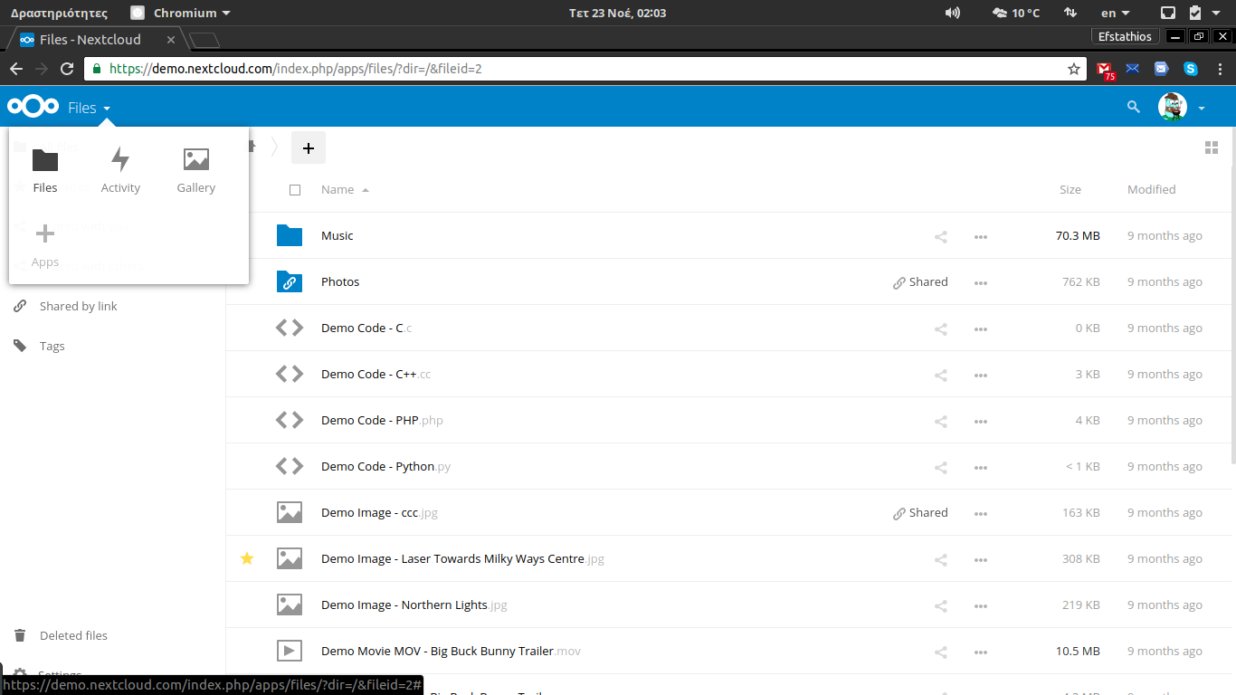

Slide 27
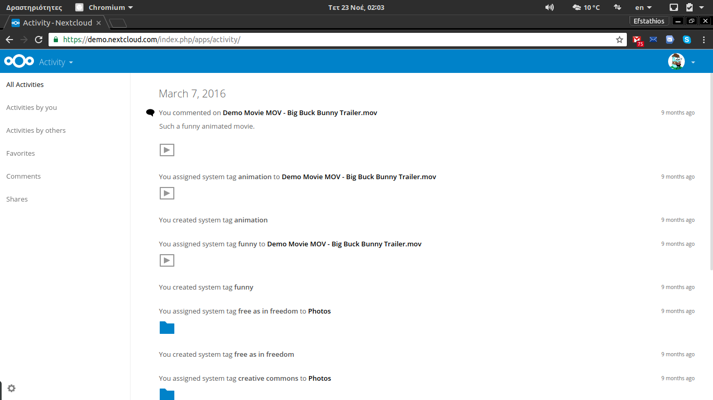

Slide 29
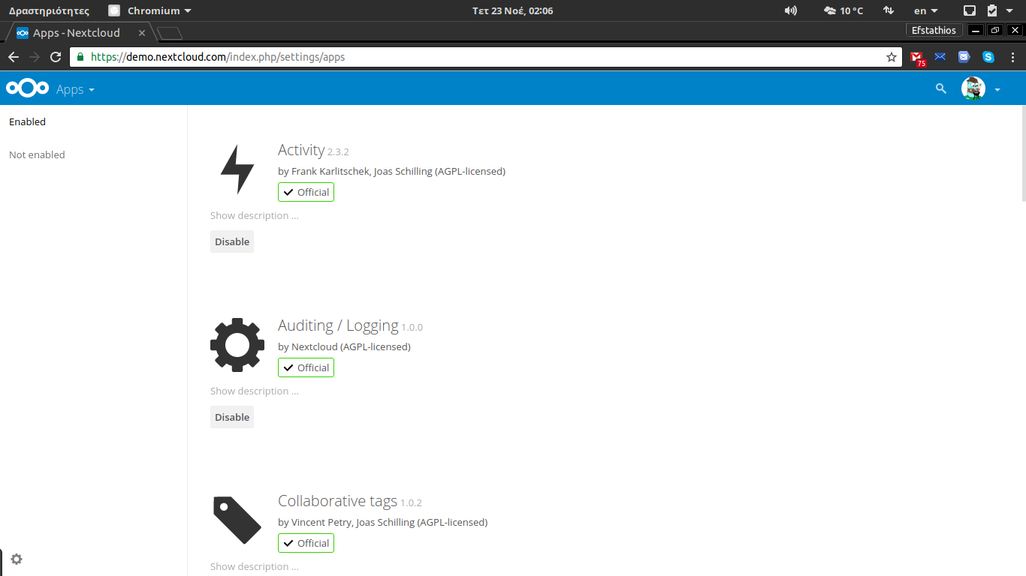

Slide 30
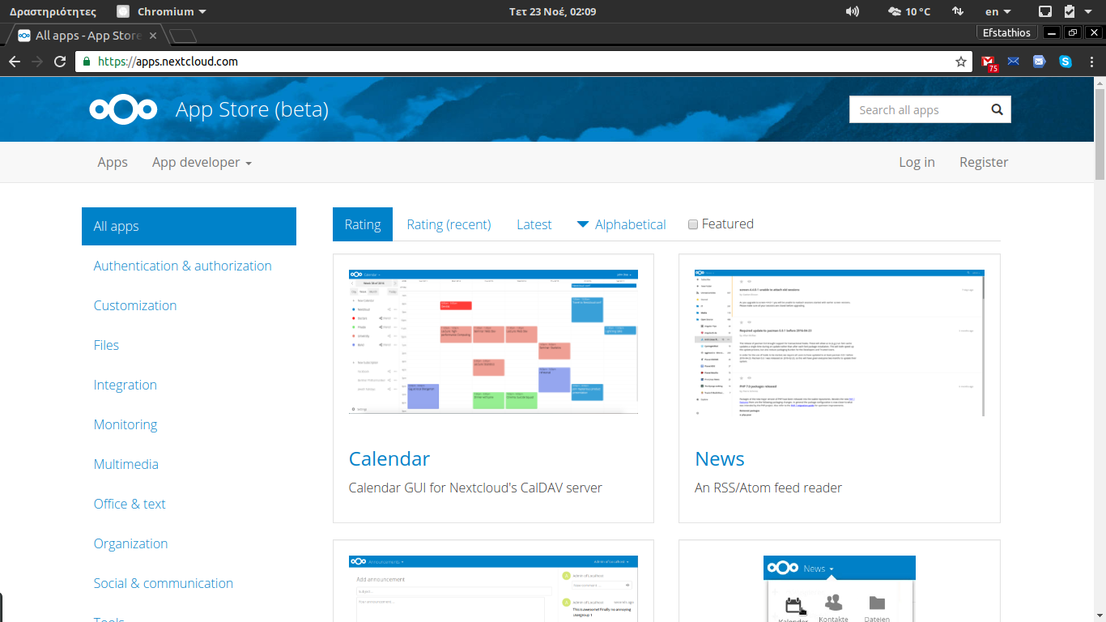

Slide 31
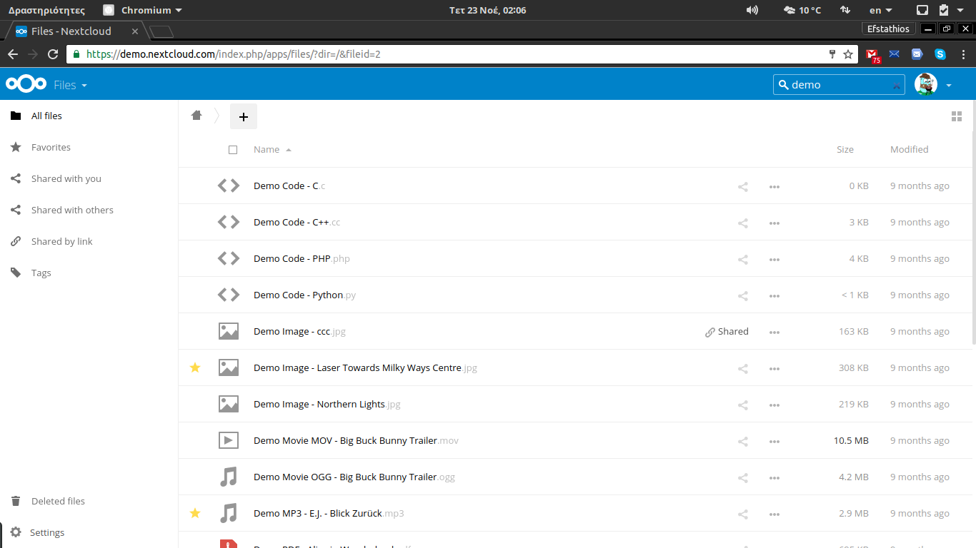

Slide 32
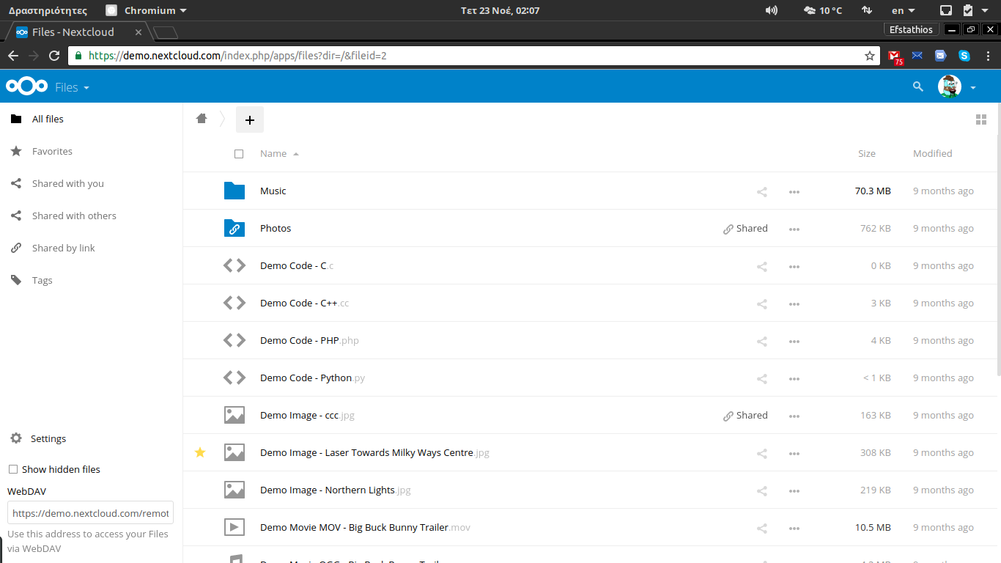

Slide 34
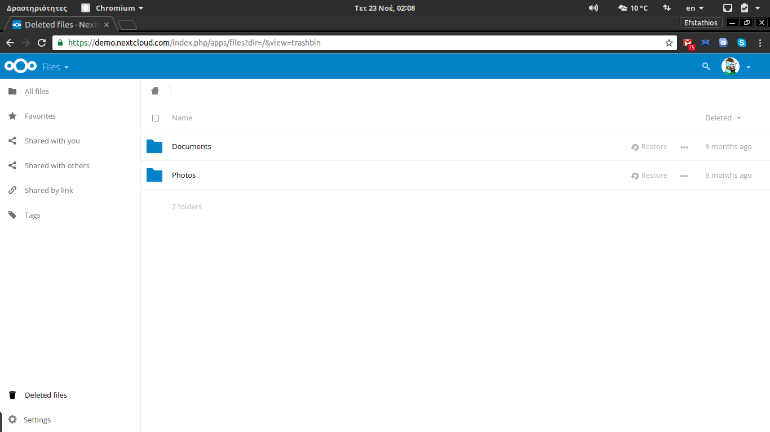

Slide 35
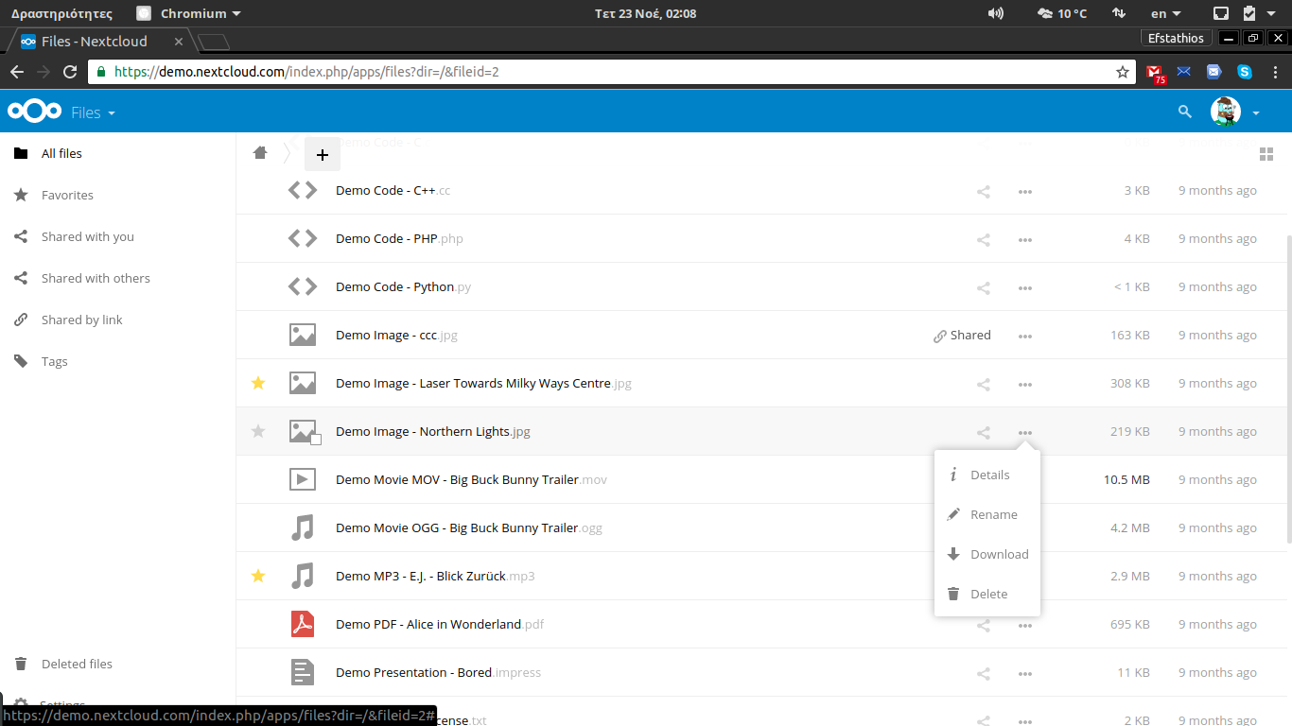

Slide 36
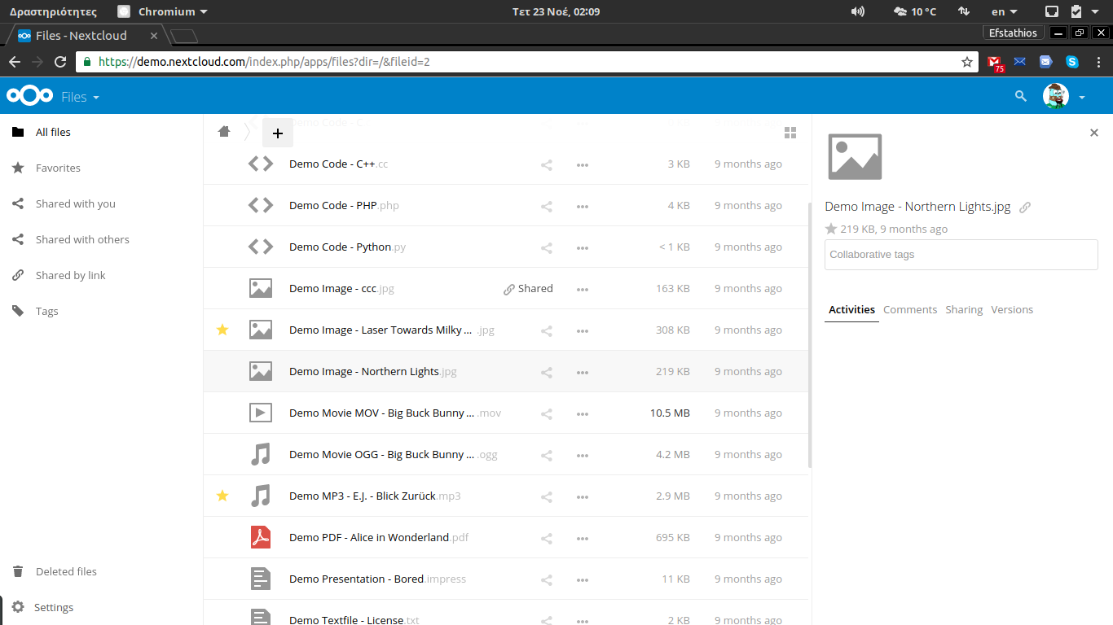

Slide 38
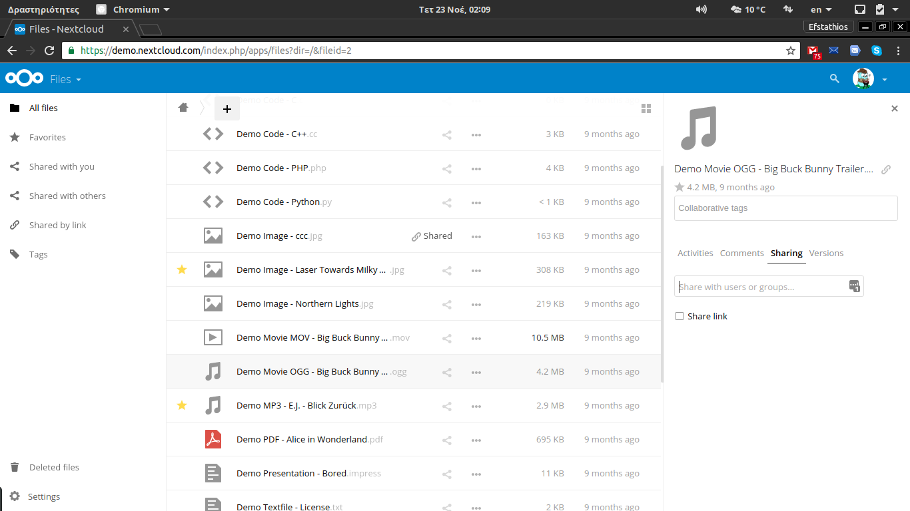

Slide 39
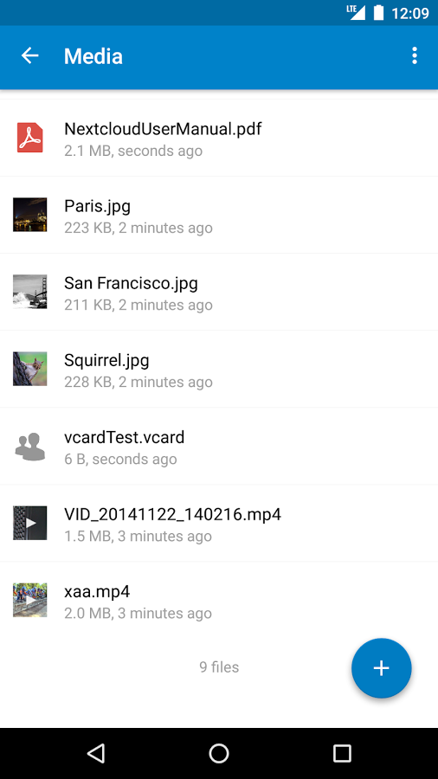
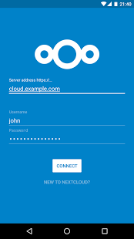

Slide 40
Nextcloud - Links
Notes:
Nextcloud is easy to maintain, but gives a lot of control to system administrators.

Slide 41
Links
Get it on nextcloud.com/download
Try it on demo.nextcloud.com
Join on nextcloud.com/contribute
Find help on docs.nextcloud.com
Forum help.nextcloud.com
Facebook www.facebook.com/groups/nextcloudgr
Translate www.transifex.com/nextcloud/nextcloud

Slide 42
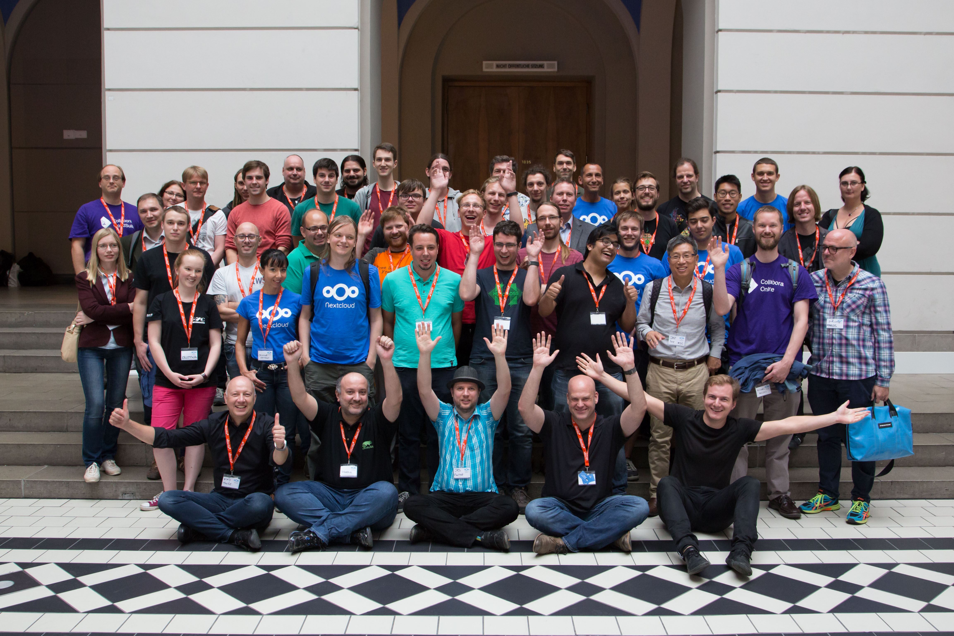
Nextcloud Contributor Conference 2016

Slide 43
Nextcloud - Questions?

